Slide 2
AUTOMATION TOOLS ANALYSIS
PRESENTER
KMS TECHNOLOGY
24 | 08 | 2015

Slide 3
Agenda
HP UFT
Test Architect
Test Complete
Rapise
Telerik Test Studio
Ranorex
qAutomate
SilkTest
SeeTest Automation
Selenium WebDriver
CodedUI
Robot Framework
TestNG
Cucumber
JUnit
NUnit
Watir
Jubula
Sahi
SeLion
Automation tools analysis

Slide 4
HP UFT
Automation tools analysis

Slide 5
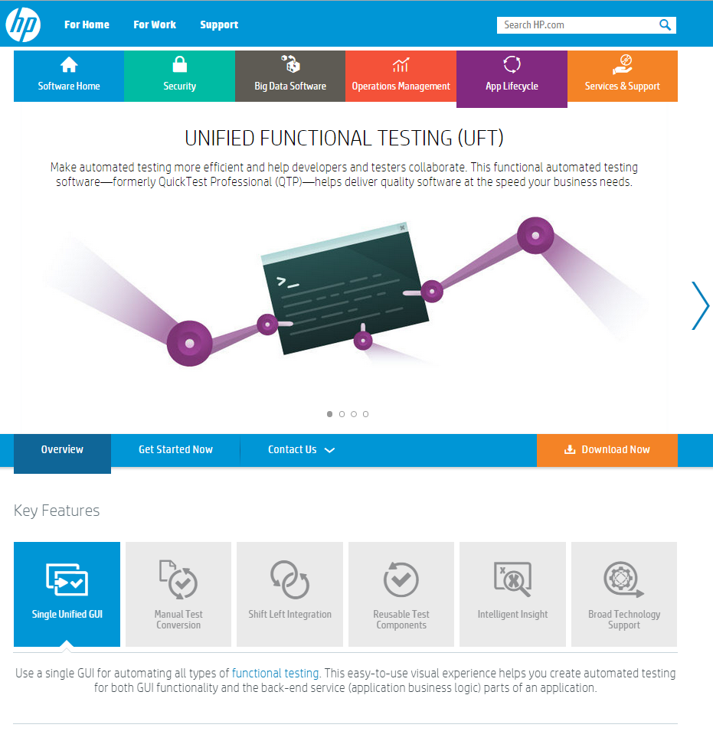
HP UFT - HOMEPAGE
http://www8.hp.com/us/en/software-solutions/unified-functional-automated-testing/
Automation tools analysis

Slide 6
HP UFT - INTRODUCTION
Provides functional and regression test automation for software applications and environments.
Make automated testing more efficient and help developers and testers collaborate.
Helps deliver quality software at the speed your business needs.
Integrated with HP’s Test Management tool, Quality Center (QC).
Execution time is high as it takes the entire load on CPU & RAM.
Cannot run multiple threads/instances
Target Market:
Transportation
Insurance
Financial Services
Automation tools analysis

Slide 7
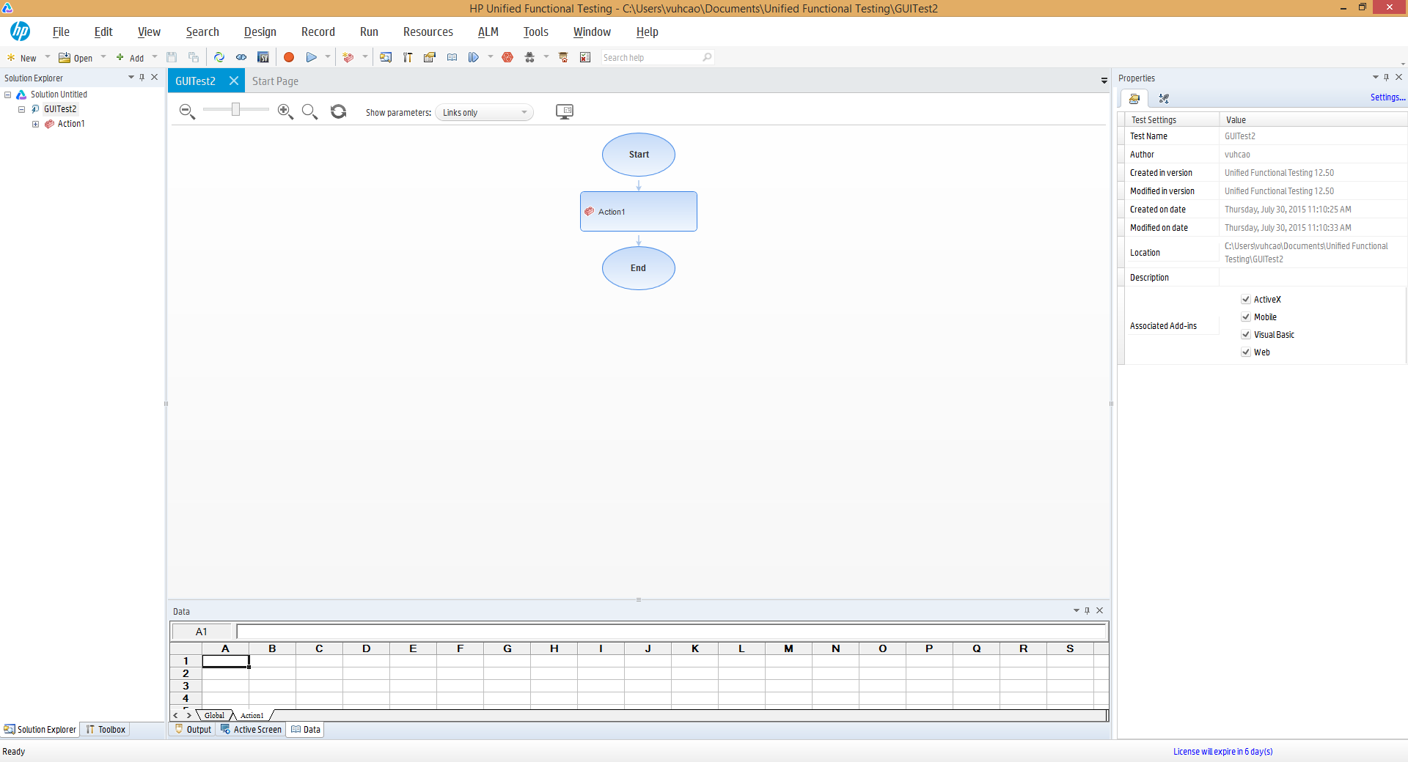
HP UFT - Screenshots
Main screen
Automation tools analysis

Slide 8
TESTARCHITECT
Automation tools analysis

Slide 9
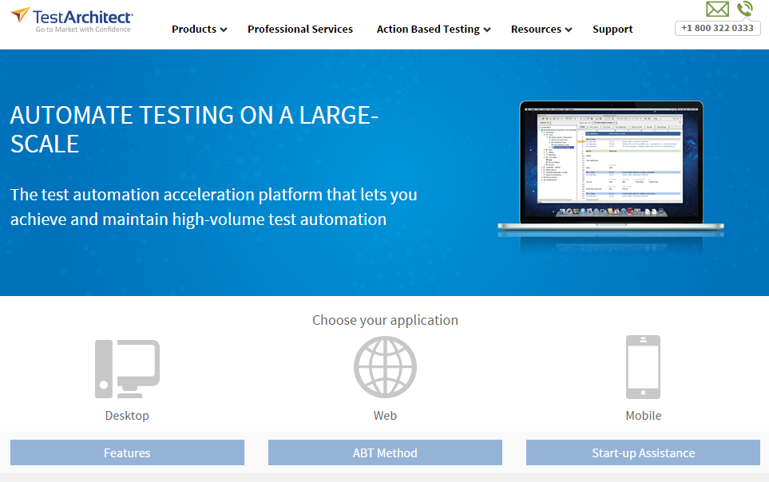
TESTARCHITECT - HOMEPAGE
http://testarchitect.logigear.com
Automation tools analysis

Slide 10
TestArchitect - INTRODUCTION
A module-based test automation acceleration platform designed for team based testing.
Quickly develop a large volume of scalable and easy to maintain tests for mobile, browser and desktop, applications.
Centralized repository allows remote teams to leverage reusable test assets.
Not ideal for small-scale test creation.
Built-in extensibility offers complete customization and integration with non-standard applications and 3rd party test and ALM tools.
Eclipse, HP Quality Center, Microsoft Test Manager®, Continuous integration tools, JIRA Zephyr, LDAP.
Automation tools analysis

Slide 11
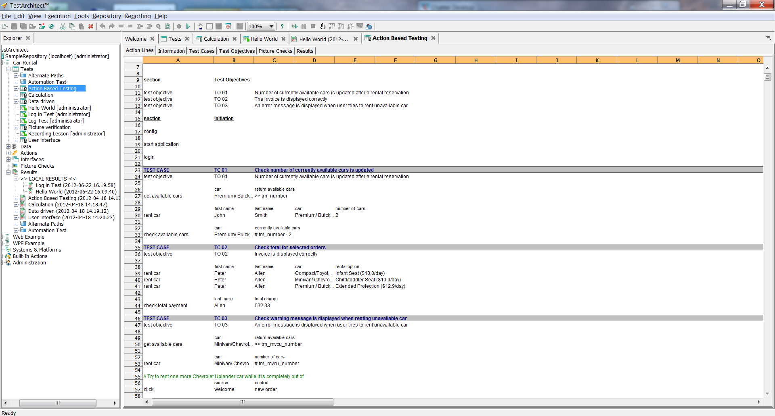
TESTARCHITECT - Screenshots
Main screen
Automation tools analysis

Slide 12
TESTCOMPLETE
Automation tools analysis

Slide 13
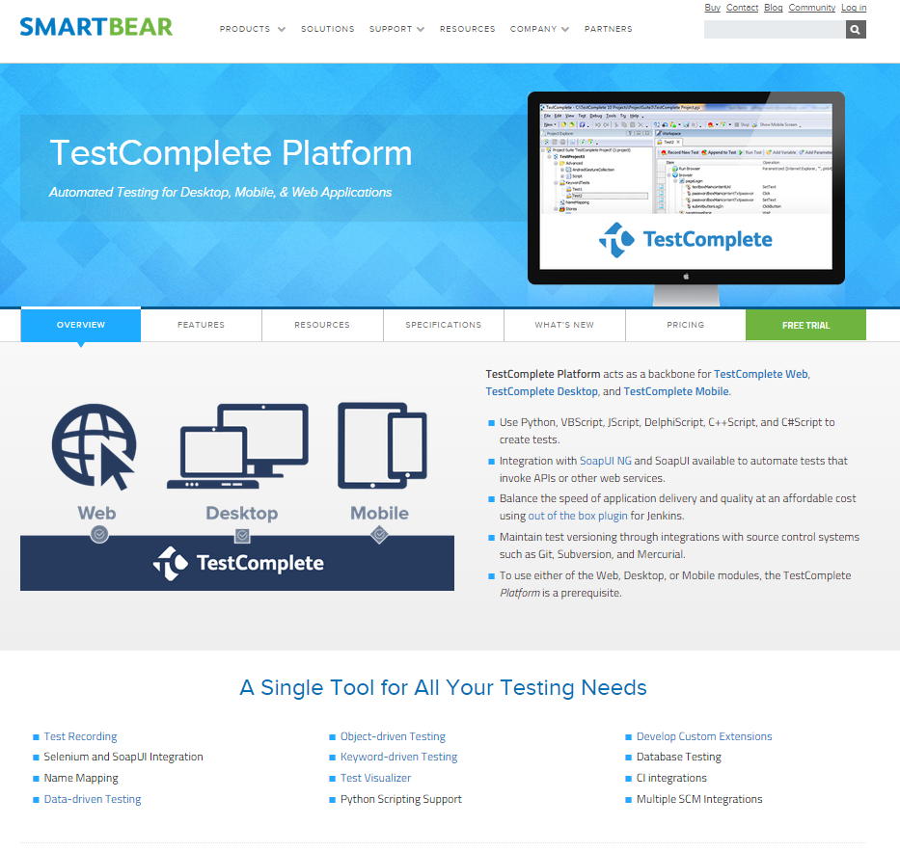
TESTcomplete - HOMEPAGE
http://smartbear.com/product/testcomplete/overview/
Automation tools analysis

Slide 14
Testcomplete - INTRODUCTION
TestComplete Platform has an open flexible architecture that makes creating, maintaining, and executing automated tests across desktop, web, mobile easy, speedy, and cost effective.
TestComplete has been on the forefront of best-in-class automated testing at an affordable price.
For small to mid-size teams looking to automate a portion of their software testing.
Hand-scripting can be difficult for novice or non-technical testers.
Trusted by 5000+ companies, included: Cisco, J.P.Morgan, Boeing, McAfee, EMC, Thomson Reuters…
Automation tools analysis

Slide 15
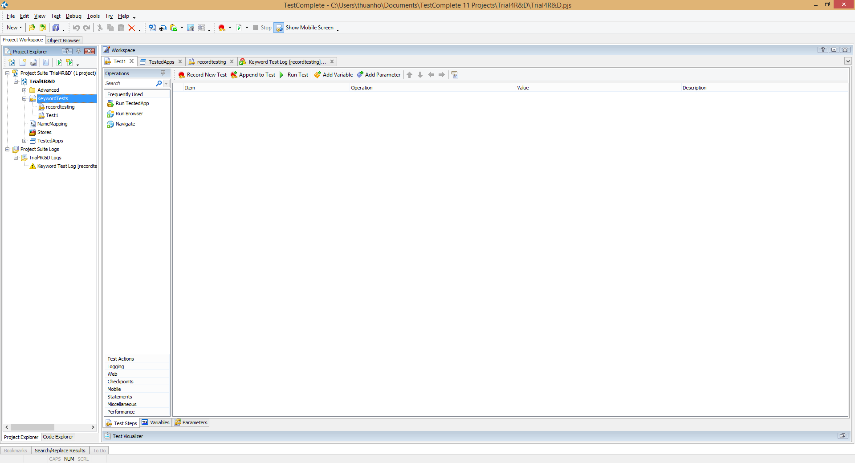
TESTcomplete - Screenshots
Main screen
Automation tools analysis

Slide 16
RAPISE
Automation tools analysis

Slide 17
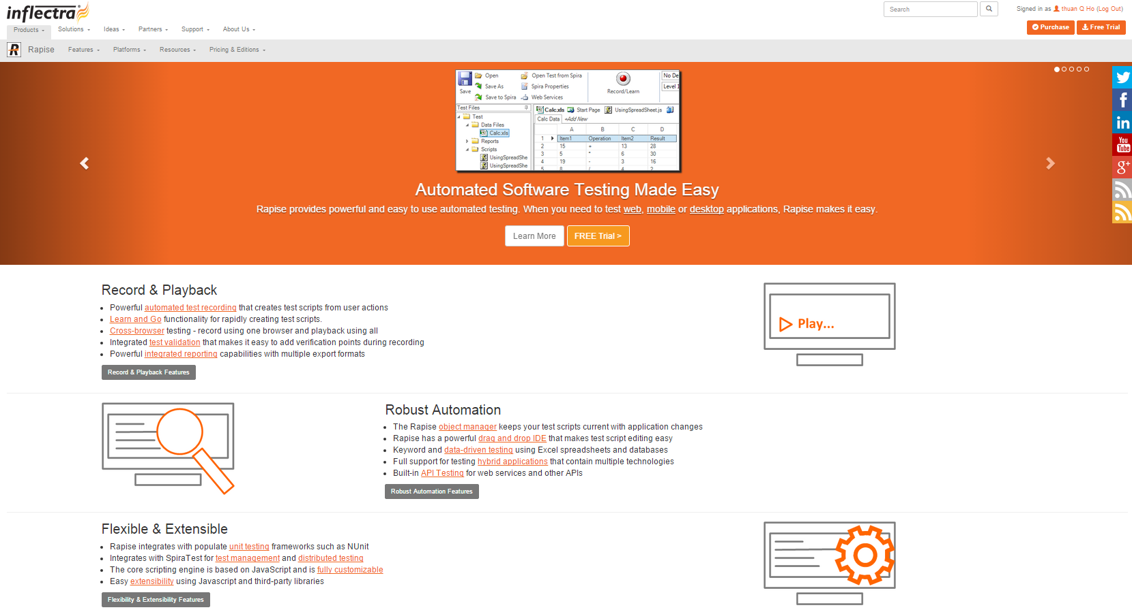
RAPISE - HOMEPAGE
https://www.inflectra.com/Rapise/
Automation tools analysis

Slide 18
RAPISE - INTRODUCTION
Provides powerful and easy tool to use for automated testing.
Test all of the different platforms and technologies.
Simplifies Automated Test Maintenance
Supports almost platform for testing
Tool does not integrate with Selenium. Tool runs based on its own framework.
Trusted by: Energy, Financial, Business Services, Information Technology, Healthcare, Bio-Technology, Telecommunications, Retail & Consumer Goods, Transportation & Hospitality company.
Automation tools analysis

Slide 19
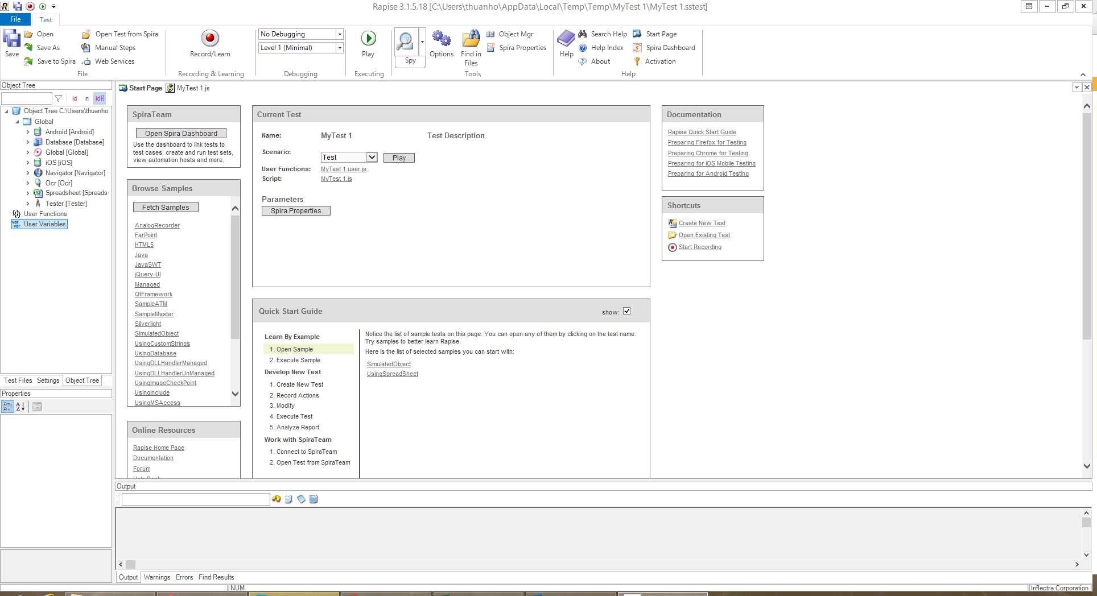
RAPISE - Screenshots
Main screen
Automation tools analysis

Slide 20
TELERIK TEST STUDIO
Automation tools analysis

Slide 21
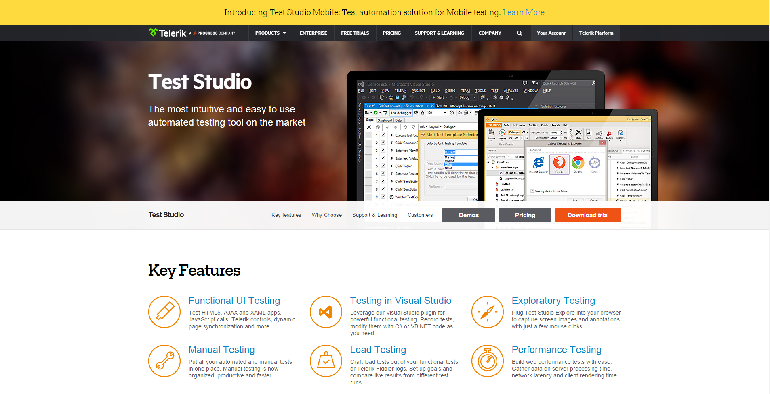
TELERIK TEST STUDIO - HOMEPAGE
http://www.telerik.com/teststudio
Automation tools analysis

Slide 22
TELERIK TEST STUDIO - INTRODUCTION
A Windows-based software testing tool for:
Web and desktop functional testing
Software performance testing
Load testing
Mobile application testing.
Supports HTML, AJAX, Silverlight, ASP.NET MVC, JavaScript, WPF and test execution in Internet Explorer, Firefox, Safari, Chrome.
Only running on .NET environment.
Hundreds of customers including Symantec, GE, Dell, Microsoft, HP and more rely on Test Studio.
Automation tools analysis

Slide 23
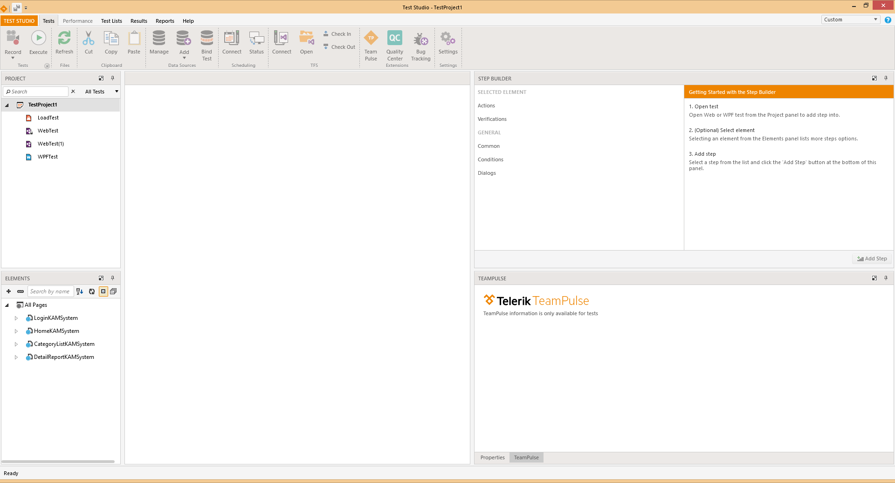
TELERIK TEST STUDIO - Screenshots
Main screen
Automation tools analysis

Slide 24
RANOREX
Automation tools analysis

Slide 25
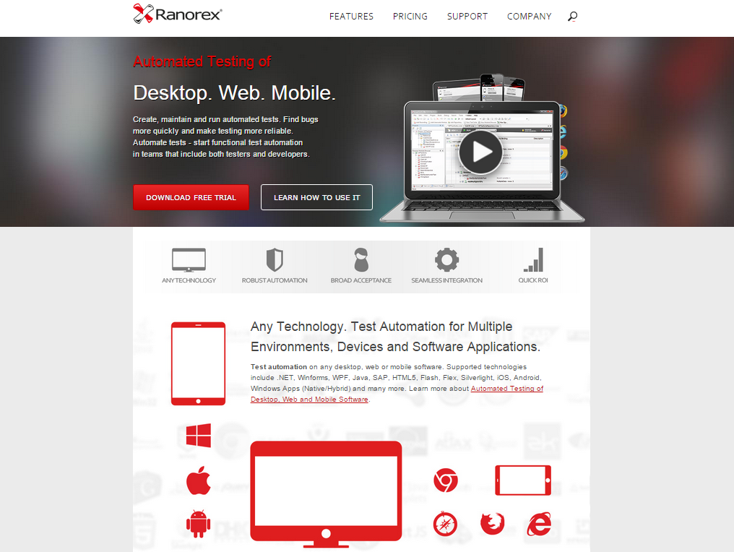
RANOREX - HOMEPAGE
http://www.ranorex.com/
Automation tools analysis

Slide 26
RANOREX - INTRODUCTION
Ranorex is a GUI test automation framework for testing of desktop, web-based and mobile applications.
Ranorex does not have a scripting language of its own, instead using standard programming languages such as C# and VB.NET as a base.
Tool is easy to learn and has many workarounds
Use Xpath to identify object but many times that elements are not identified during runtime
Trusted by 2000+ companies over 60 countries included: Yahoo!, Barclays, Motorola, Tomtom, SAP, Cisco, Philips, Siemens...
Automation tools analysis

Slide 27
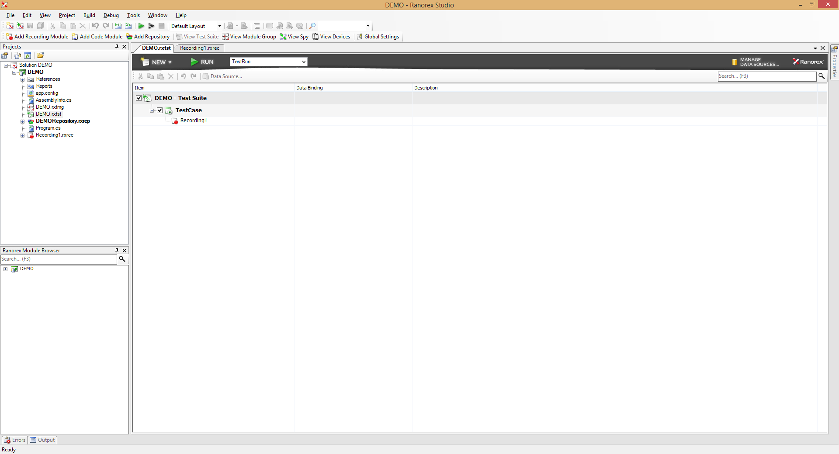
RANOREX - Screenshots
Main screen
Automation tools analysis

Slide 28
QAUTOMATE
Automation tools analysis

Slide 29
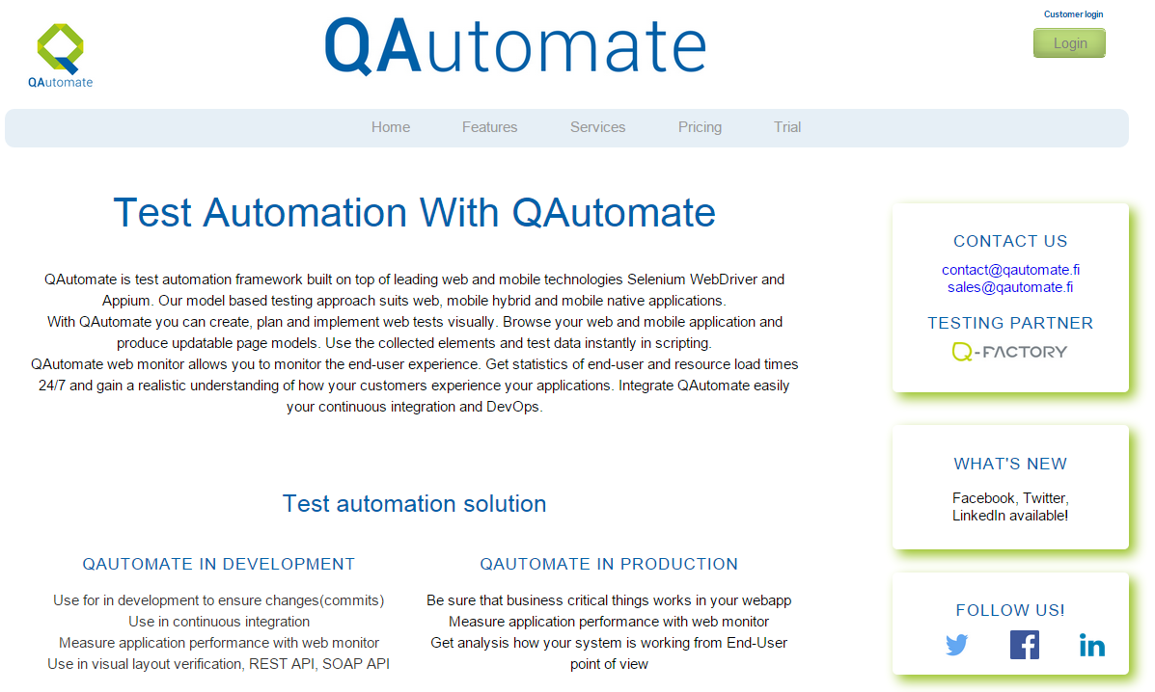
QAUTOMATE - HOMEPAGE
http://www.qautomate.fi/
Automation tools analysis

Slide 30
QAUTOMATE - INTRODUCTION
Test automation framework built on top of leading web and mobile technologies Selenium WebDriver and Appium. Model based testing approach suits web, mobile hybrid and mobile native applications.
Support many popular tool for user to integrate: Jenkins, JIRA, SVN, GIT, Github, Bamboo, TestLink
Does neither support for tesing desktop application nor iOS devices, nor windows phone devices.
Can monitor the end-user experience. Get statistics of end-user and resource load times 24/7 and gain a realistic understanding of how your customers experience your applications.
Automation tools analysis

Slide 31
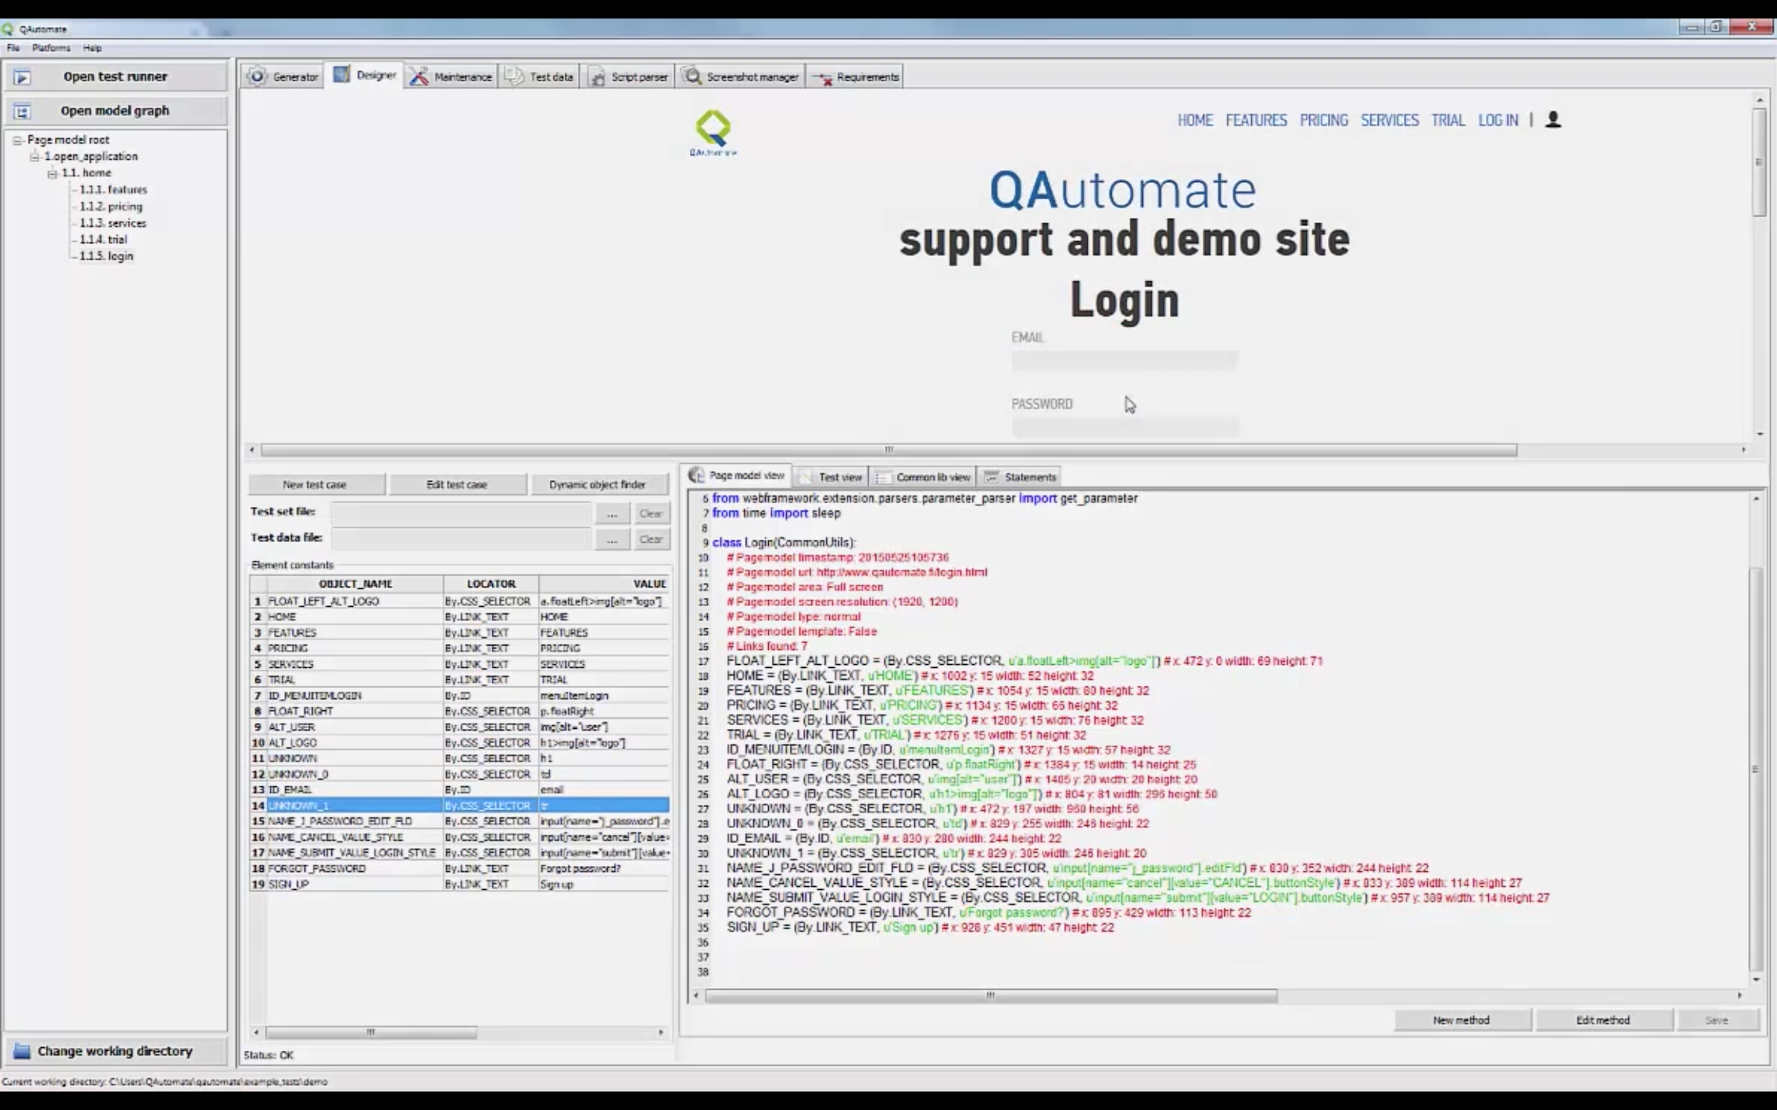
QAUTOMATE - Screenshots
Main screen
Automation tools analysis

Slide 32
SILKTEST
Automation tools analysis

Slide 33
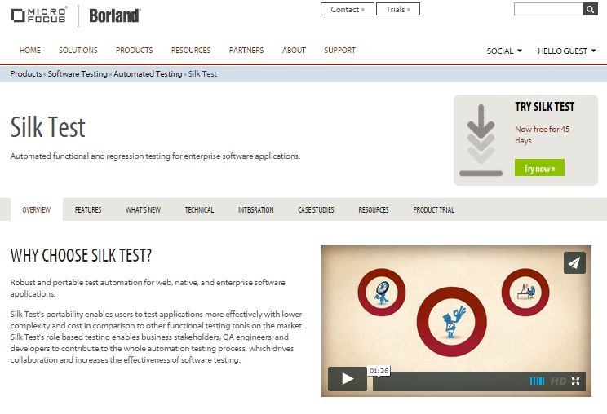
SILKTEST - HOMEPAGE
http://www.borland.com/Products/Software-Testing/Automated-Testing/Silk-Test
Automation tools analysis

Slide 34
SILKTEST - INTRODUCTION
Robust and portable test automation for web, native, and enterprise software applications.
Silk Test's portability enables users to test applications more effectively with lower complexity and cost.
Supports AJAX/Flex/Web 2.0, Java, .NET, client/server system.
Limit in supporting only Windows applications and only through Internet Explorer and Mozilla browsers on Windows.
Trusted by: AAA Life Insurance Company, USA Technologies, HUK-COBURG, Sogeti, YMOR, Wisconsin, Synergex, Telefónica, ReadyTalk, Raiffeisen Bank, Quality Kiosk…
Automation tools analysis

Slide 35
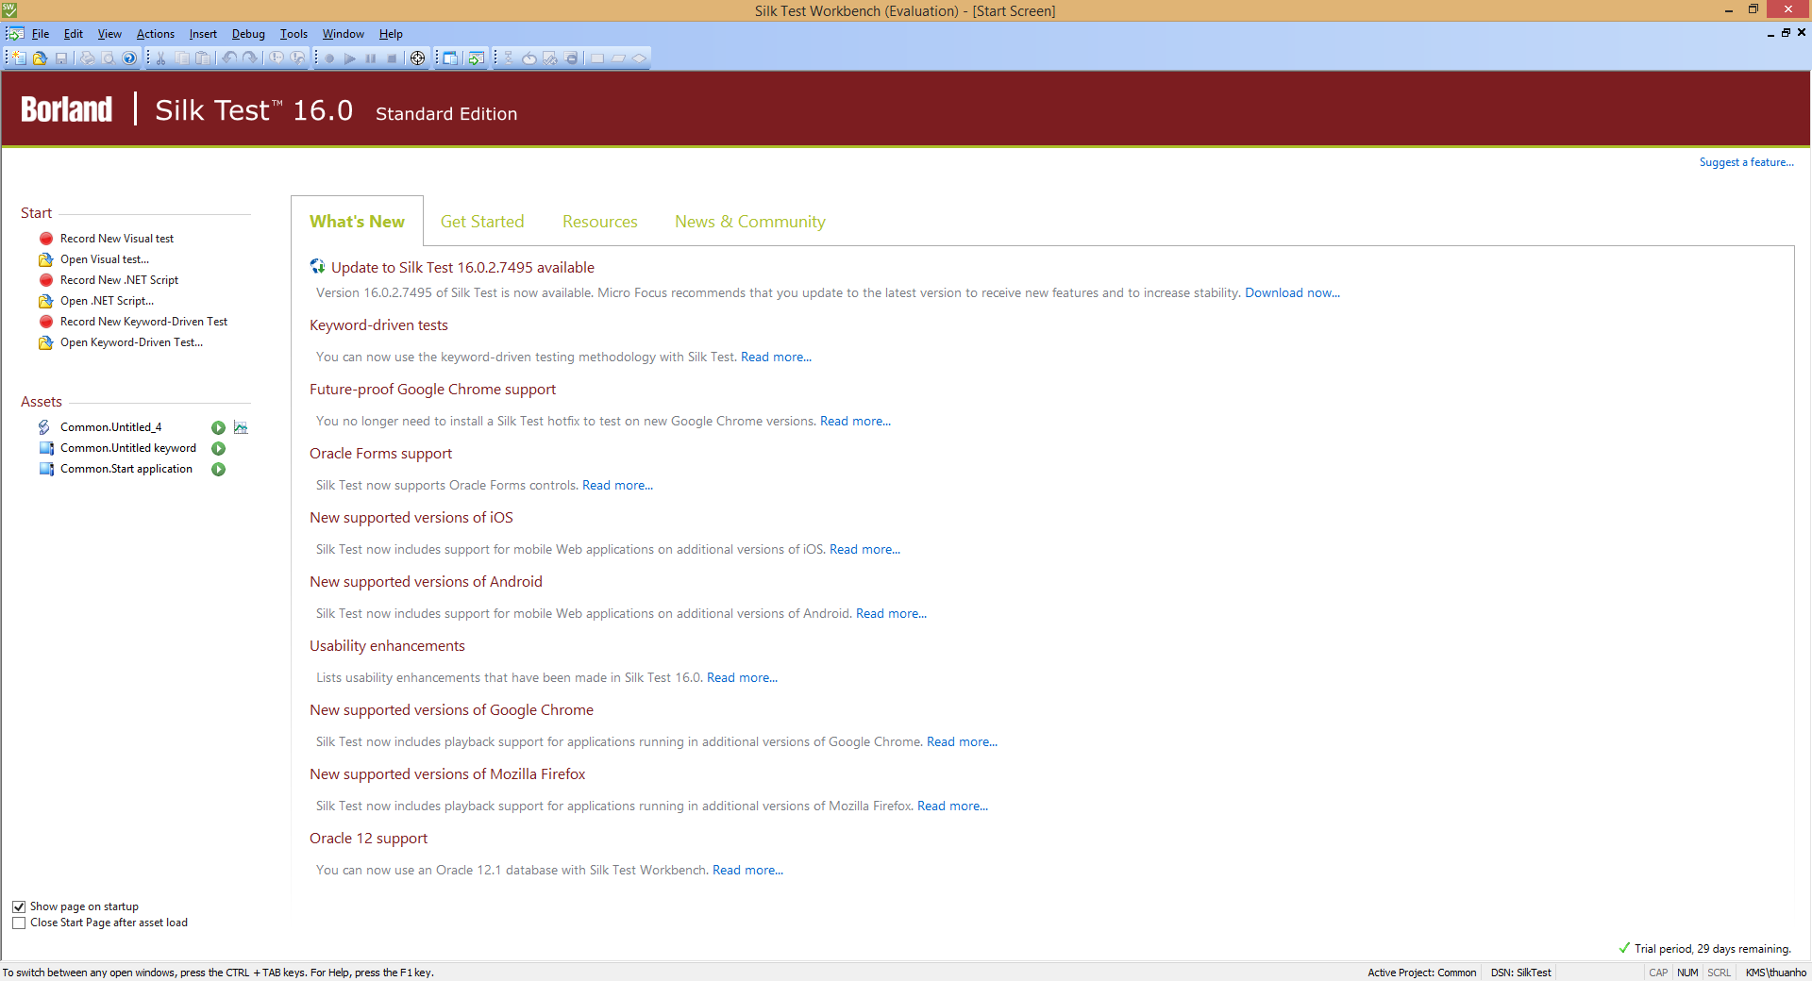
SILKTEST - Screenshots
Main screen
Automation tools analysis

Slide 36
SEETEST AUTOMATION
Automation tools analysis

Slide 37
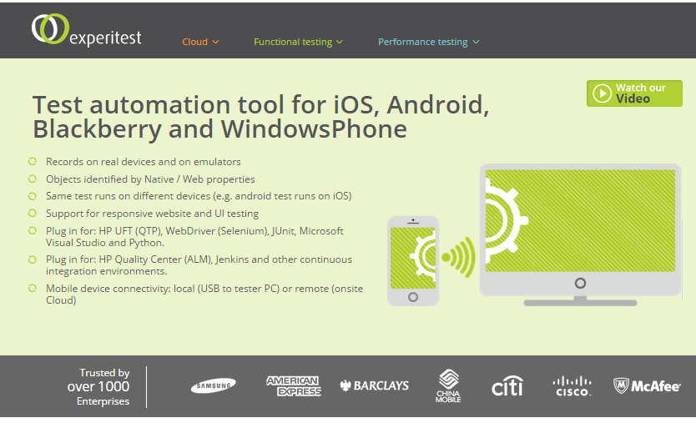
SEETEST AUTOMATION - HOMEPAGE
https://experitest.com/automation/
Automation tools analysis

Slide 38
SEETEST AUTOMATION - INTRODUCTION
Uses a simple plug, record and play mechanism. It is easy to connect via USB, WiFi or an internal cloud. No need to code writing due to the recording of actions performed and all functions and gestures are supported.
Same test runs on different devices (e.g. android test runs on iOS). Support for responsive website and UI testing
Cannot run multiple browser
Trusted by 1000+ enterprise in: Bank (currently 7/10 largest banks around the world), Healthcare, Communications…
Automation tools analysis

Slide 39
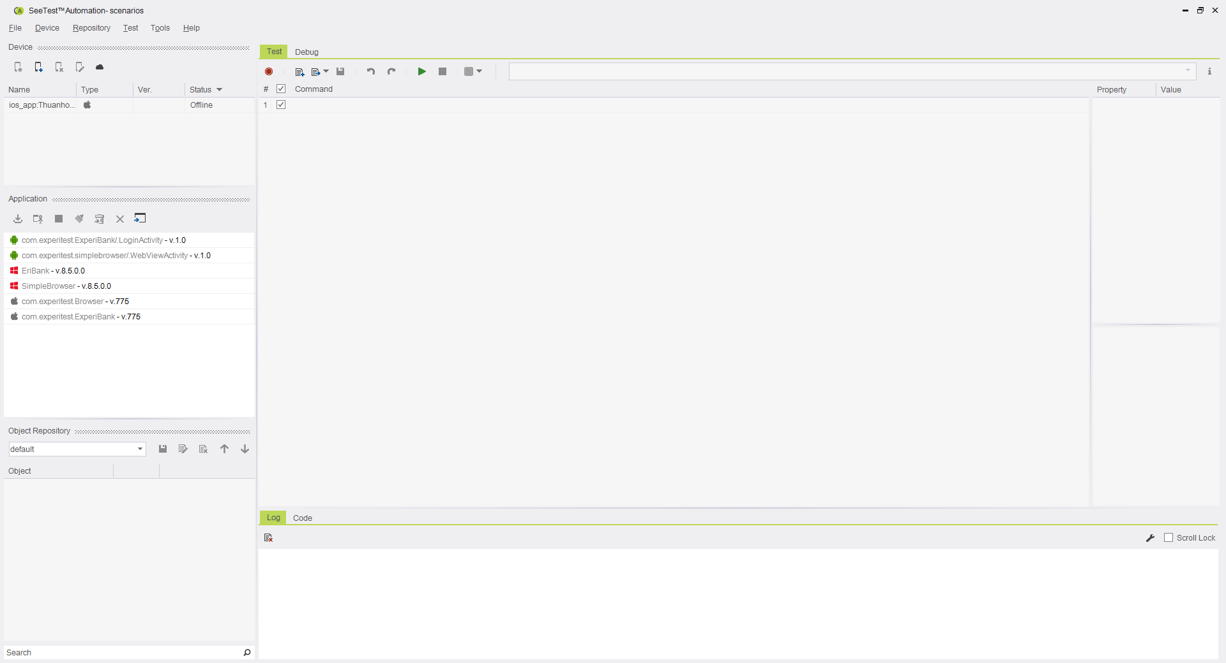
SEETEST AUTOMATION - Screenshots
Main screen
Automation tools analysis

Slide 40
SELENIUM WEBDRIVER
Automation tools analysis

Slide 41
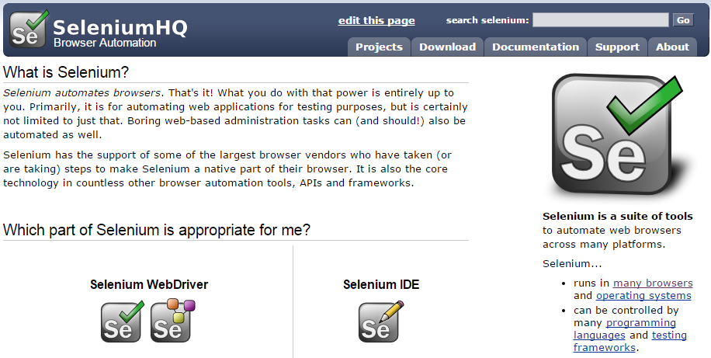
SELENIUM WEBDRIVER - HOMEPAGE
http://www.seleniumhq.org/
Automation tools analysis

Slide 42
SELENIUM WEBDRIVER - INTRODUCTION
Selenium is a portable software testing framework for web applications
It provides a test domain-specific language (Selenese) to write.
The tests can then be run against most modern web browsers. Selenium deploys on Windows, Linux, and Macintosh platforms.
Just for automating browser testing only. Tests are challenging to scale and maintain for large-scale projects.
Selenium has the support of some of the largest browser vendors who have taken steps to make Selenium a native part of their browser. It is also the core technology in countless other browser automation tools, APIs and frameworks.
Automation tools analysis

Slide 43


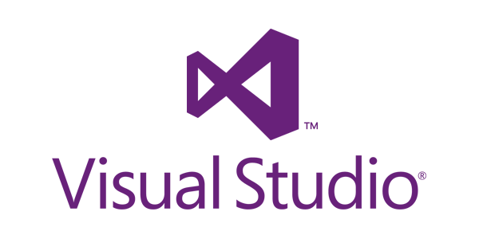

SELENIUM WEBDRIVER - IDE
Famous IDEs that Selenium run on
Automation tools analysis

Slide 44
CODEDUI
Automation tools analysis

Slide 45
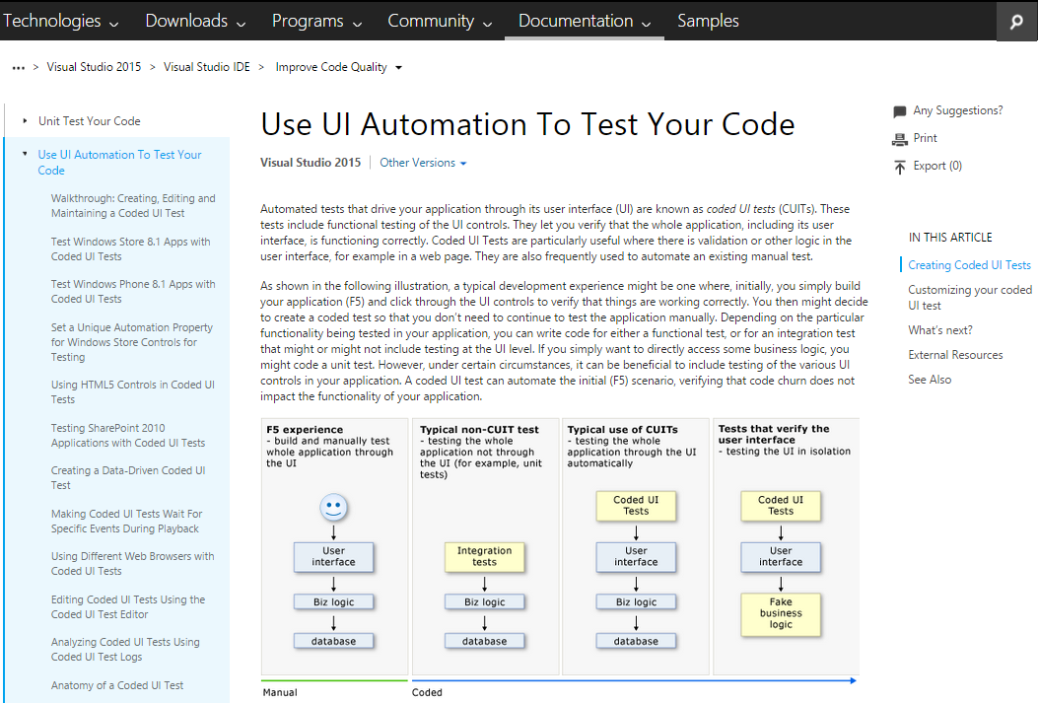
CODEDUI - HOMEPAGE
https://msdn.microsoft.com/en-us/library/dd286726.aspx#verifyingcodeusingcuitcreate
Automation tools analysis

Slide 46
CODEDUI - INTRODUCTION
Coded UI tests are innovative capability of Visual Studio 2010.
Offer a way to create entirely automated tests which work at user interface level to certify the functionality and behavior of an application.
Useful where there is validation or other logic in the user interface, for example in a web page.
The automated recorded actions can be repeated any number of times after a change is made in a build.
Test creation is time consuming and Coded UI generates a large amount of C#-only code, even for small UI operations, complicating test maintenance.
Automation tools analysis

Slide 47
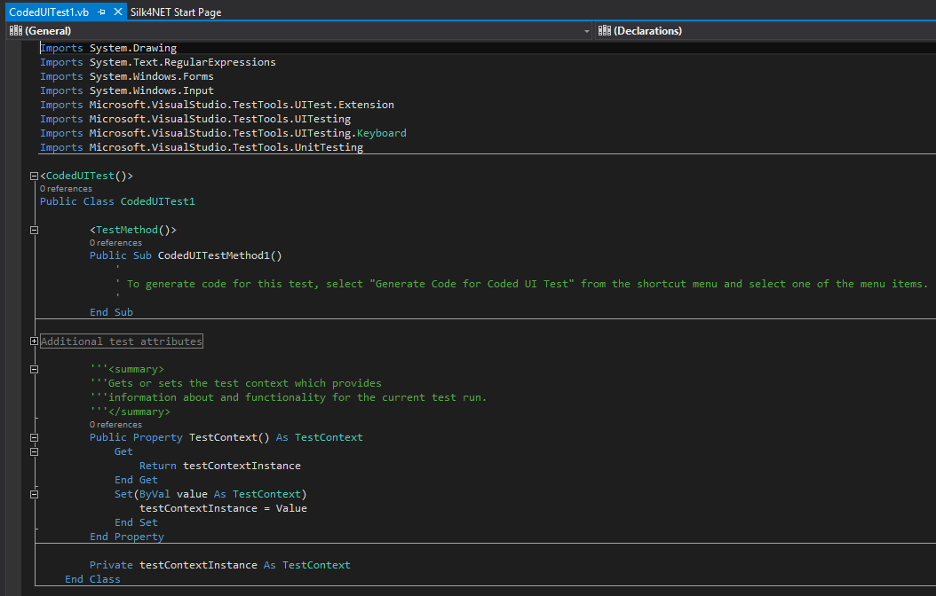
CODEDUI - SYNTAX
Editor: Visual Studio
Automation tools analysis

Slide 48
ROBOT FRAMEWORK
Automation tools analysis

Slide 49
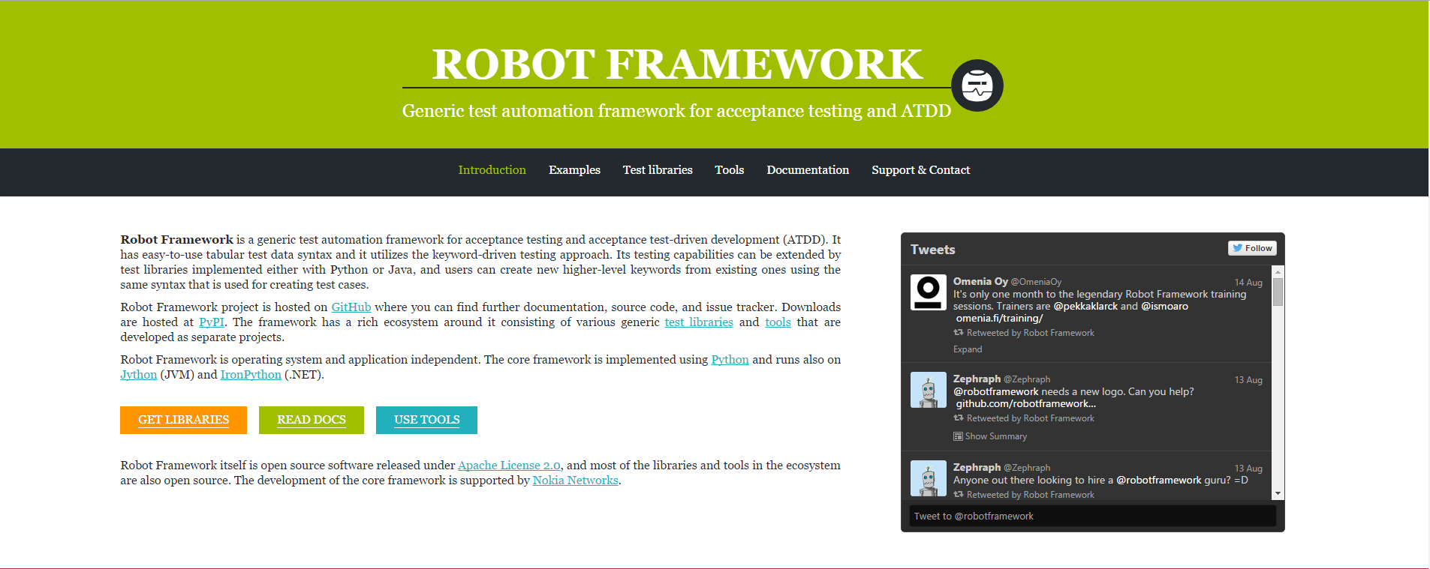
ROBOT FRAMEWORK - HOMEPAGE
http://robotframework.org/
Automation tools analysis

Slide 50
ROBOT FRAMEWORK - INTRODUCTION
An open source, python-based.
A generic test automation framework:
Utilizes the keyword-driven testing approach.
Suitable both for "normal" automation and ATDD.
Has a rich ecosystem around it consisting of various generic test libraries and tools that are developed as separate projects.
Doesn't run in parallel.
Lack of decent IDE and debugging.
Target market: Networks, Delivery email, Security, Electronics companies
Automation tools analysis

Slide 51
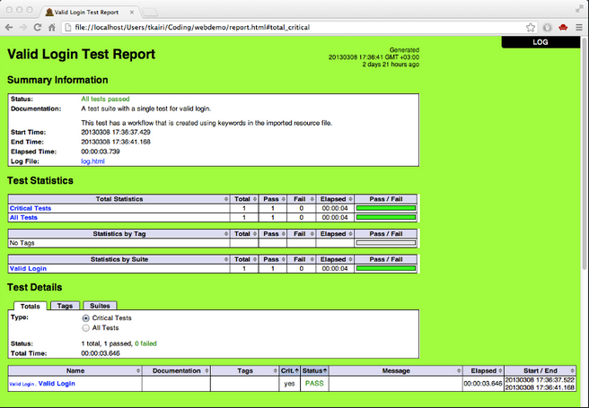
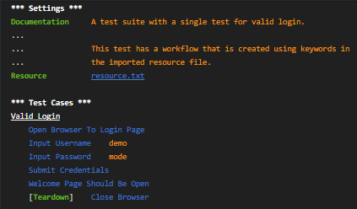
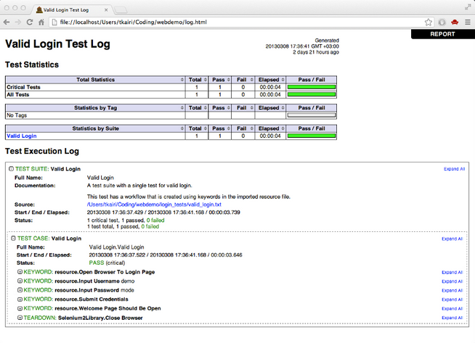
ROBOT FRAMEWORK - Screenshots
Main screen
Automation tools analysis

Slide 52
TESTNG
Automation tools analysis

Slide 53
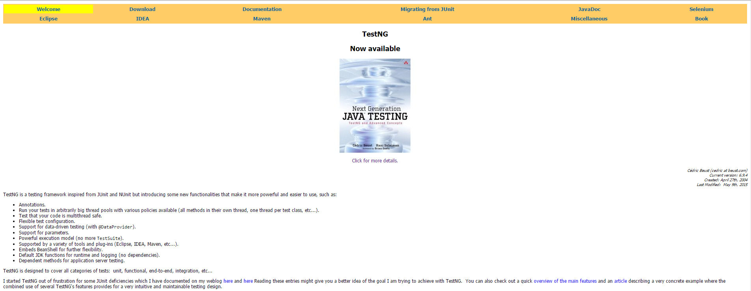
TESTNG - HOMEPAGE
http://testng.org/
Automation tools analysis

Slide 54
TESTNG - INTRODUCTION
A testing framework for the Java programming language inspired by JUnit and NUnit.
Cover a wider range of test categories: unit, functional, end-to-end, integration, etc.,
Integrates very well with popular build tools: Ant, Maven (via Maven Surefire Plugin) and Gradle. Supported by major IDEs, can be used with different JVM languages (Java, Groovy, Scala).
Does not support record/playback.
Programming skill is required.
Automation tools analysis

Slide 55
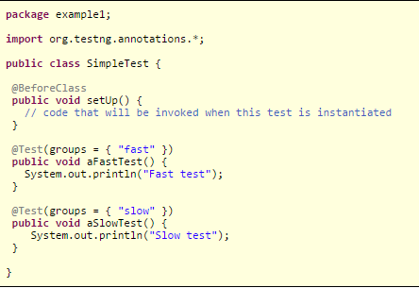

TESTNG - Screenshots
Main screen
Automation tools analysis

Slide 56
CUCUMBER
Automation tools analysis

Slide 57
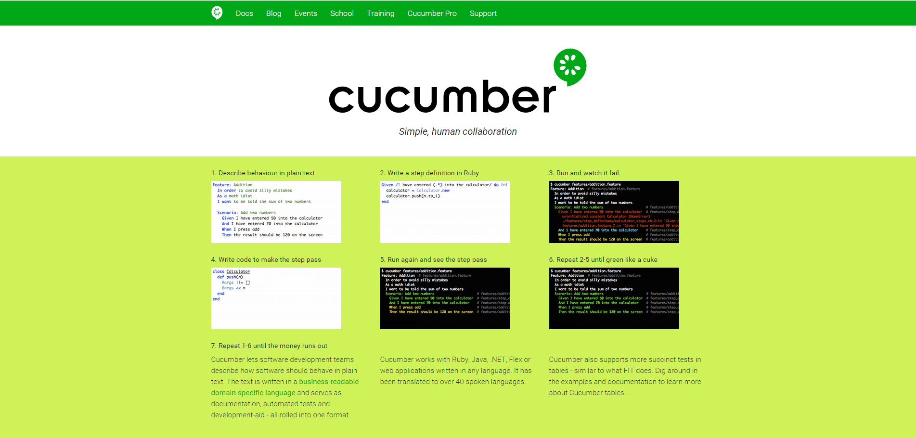
CUCUMBER - HOMEPAGE
https://cucumber.io/
Automation tools analysis

Slide 58
CUCUMBER - INTRODUCTION
Runs automated acceptance tests written in a behavior-driven development (BDD) style
=> Allows the execution of feature documentation written in business-facing text.
Cucumber can be used along with Selenium, Watir, and Capybara etc.
Cucumber supports many other languages like Perl, PHP, Python, .Net etc.
Incompatibility among GEM versions.
Lacking of tool for managing features and scenarios effectively.
Clients: Online payments system, e-commerce company, …
Automation tools analysis

Slide 59
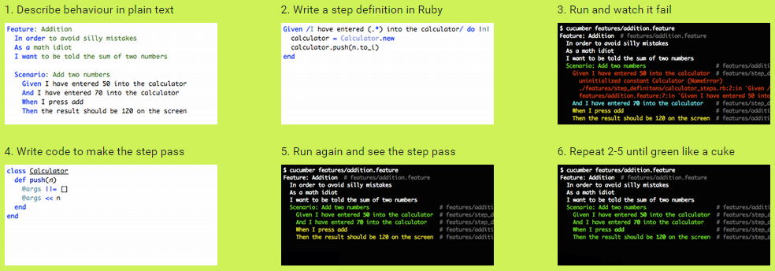
CUCUMBER - Screenshots
Main screen
Automation tools analysis

Slide 60
JUNIT
Automation tools analysis

Slide 61
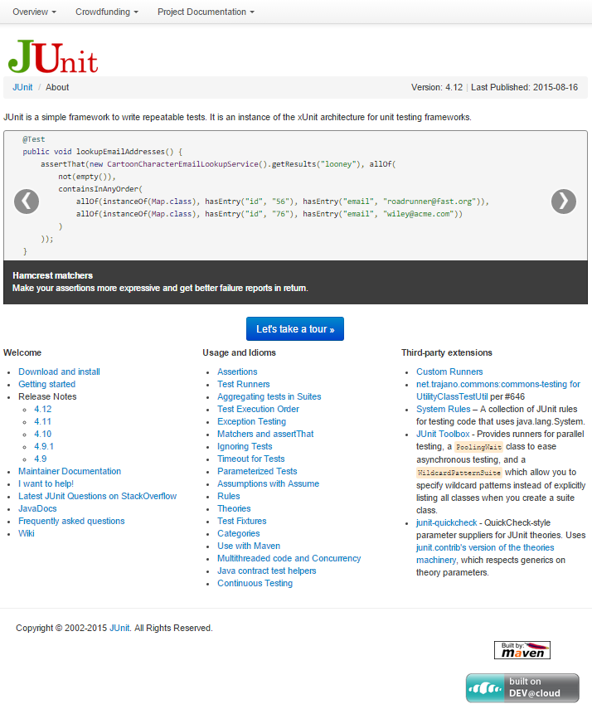
JUNIT - HOMEPAGE
http://junit.org/
Automation tools analysis

Slide 62
JUNIT - INTRODUCTION
Open source framework to write repeatable tests. An instance of the xUnit architecture for unit testing frameworks.
JUnit features include:
Assertions for testing expected results
Test fixtures for sharing common test data
Test runners for running tests
Integrate with popular tools such as Ant and Maven and IDE's like Eclipse and Jbuilder.
Do not support parallel execution of test cases. Programing skill is required
Clients: advertising business, software solutions company, ….
Automation tools analysis

Slide 63
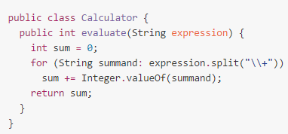
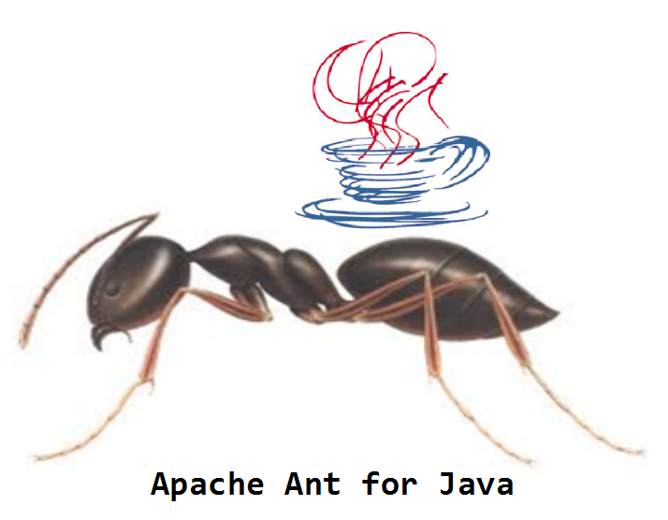
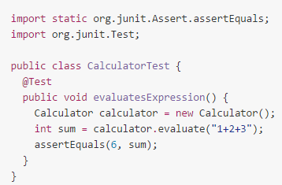
JUNIT - Screenshots
Main screen
Automation tools analysis

Slide 64
NUNIT
Automation tools analysis

Slide 65
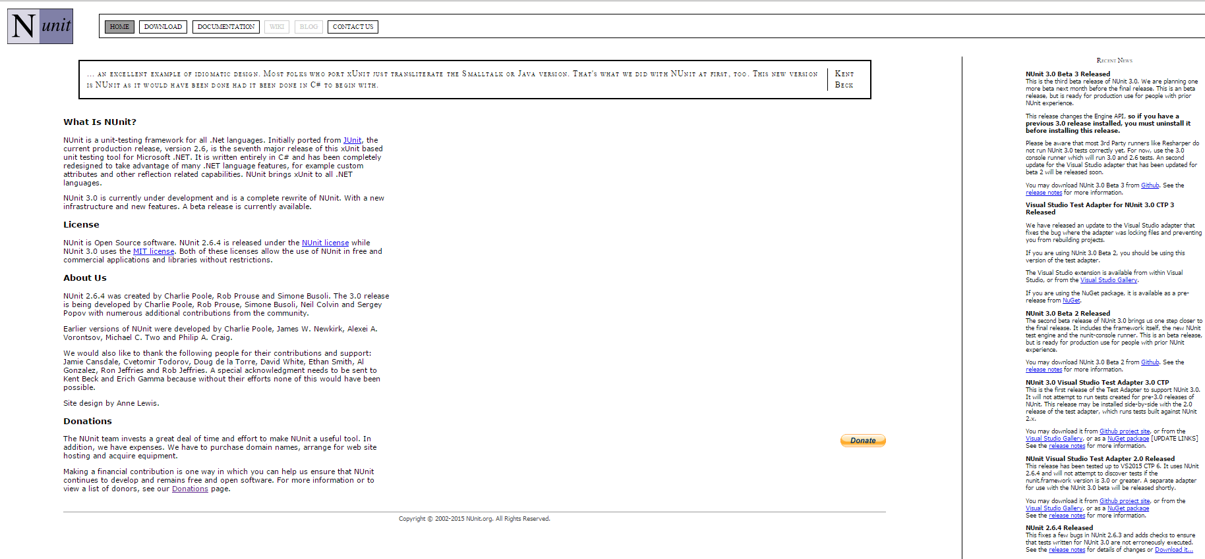
NUNIT - HOMEPAGE
http://www.nunit.org/
Automation tools analysis

Slide 66
NUNIT - INTRODUCTION
A unit-testing framework for all .Net languages.
An instance of the xUnit architecture for unit testing framework
Standalone, easy to include in source control for new developers to be running instantly.
Does not support record/playback.
Programming skill is required.
Target market: Health care, law, software companies.
Automation tools analysis

Slide 67
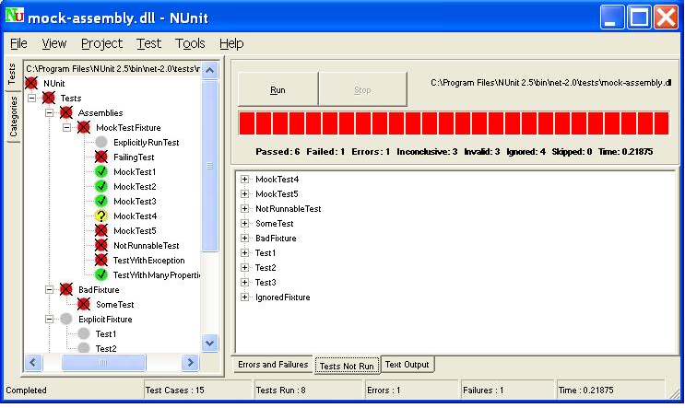
NUNIT - Screenshots
Main screen
Automation tools analysis

Slide 68
WATIR
Automation tools analysis

Slide 69
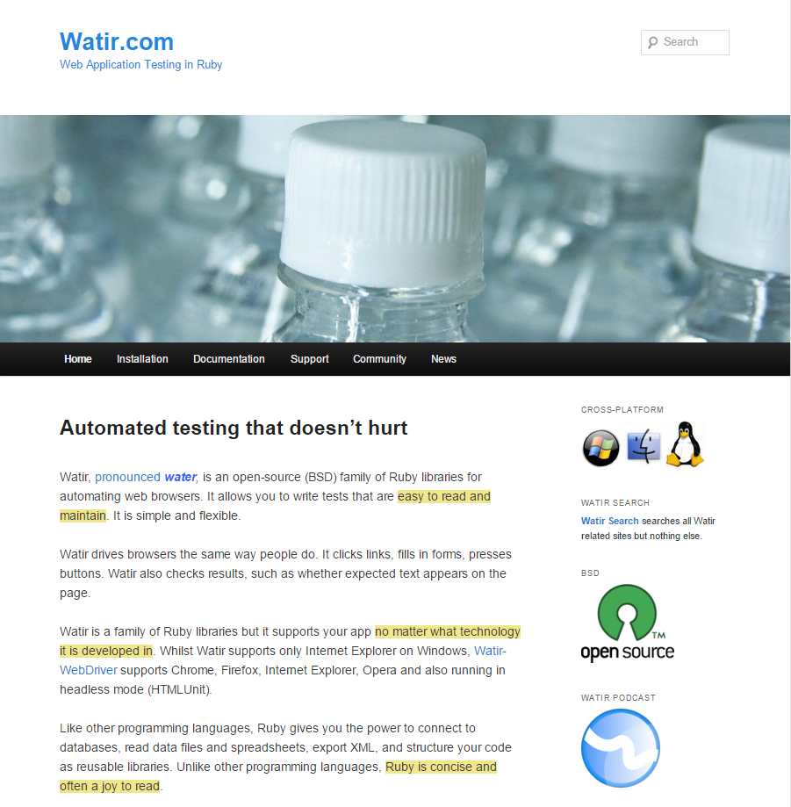
WATIR - HOMEPAGE
http://watir.com/
Automation tools analysis

Slide 70
WATIR - INTRODUCTION
An open-source (BSD) family of Ruby libraries for automating web browsers. Supports your web app no matter what technology it is developed in.
Supports multiple browsers on different platforms.
User need to learn Ruby (unless you choose Watij or Watin).
Every browser requires a different library.
Target market: Software, media, social network companies.
Automation tools analysis

Slide 71
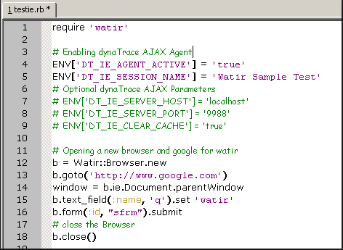
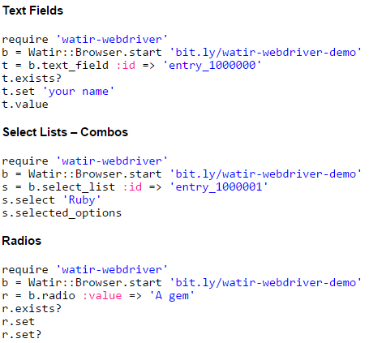
WATIR - Screenshots
Main screen
Automation tools analysis

Slide 72
JUBULA
Automation tools analysis

Slide 73
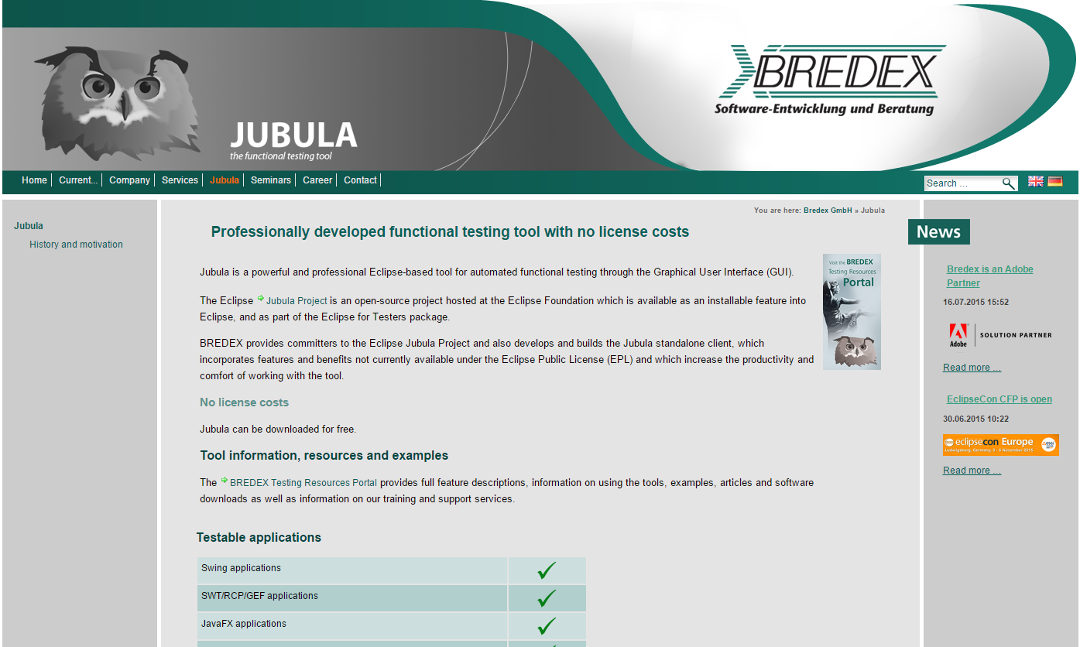
JUBULA - HOMEPAGE
http://www.bredex.de/guidancer_jubula_en.html
Automation tools analysis

Slide 74
JUBULA - INTRODUCTION
Provides automated functional GUI testing for various types of applications.
Used for automated tests written from the user perspective, without requiring any coding effort.
Jubula tests incorporate best practices from software development to ensure long-term maintainability of the automated tests.
An anchor point for a broader testing scope including requirements analysis, code coverage of Java applications and test metrics.
Does neither support for testing desktop application nor android devices, nor windows phone devices.
Automation tools analysis

Slide 75
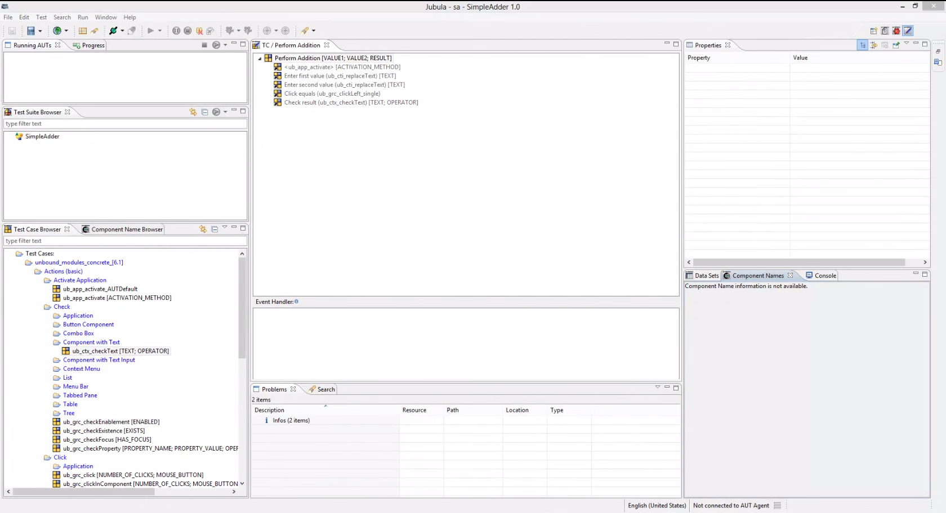
JUBULA - Screenshots
Main screen
Automation tools analysis

Slide 76
SAHI
Automation tools analysis

Slide 77
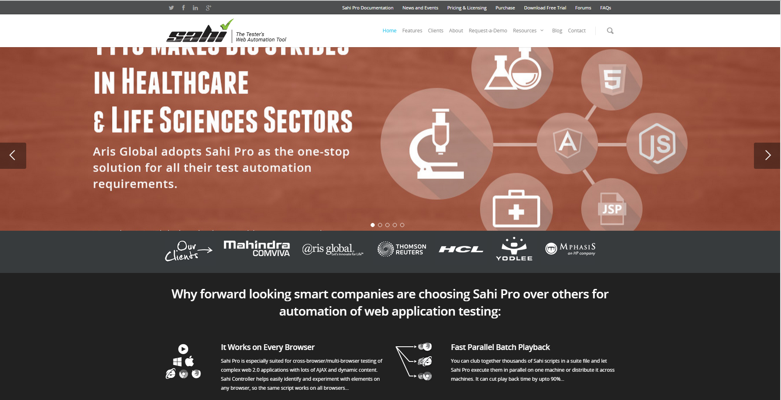
SAHI - HOMEPAGE
http://sahipro.com/
Automation tools analysis

Slide 78
SAHI - INTRODUCTION
Two versions
Open source (includes a basic tool: record on all browsers, playback, HTML playback reports, Junit style playback report, Suites and batch run, Parallel playback)
Proprietary (test distribution and report customization).
Suited for cross-browser/multi-browser testing of complex web 2.0 applications with lots of AJAX and dynamic content.
Does not let you create your test cases in other languages.
Does not command the same visibility that Selenium does.
Target market: Enterprise Clients
Automation tools analysis

Slide 79
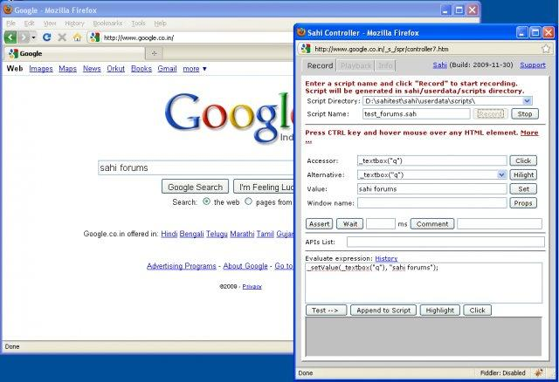
SAHI - Screenshots
Main screen
Automation tools analysis

Slide 80
SELION
Automation tools analysis

Slide 81
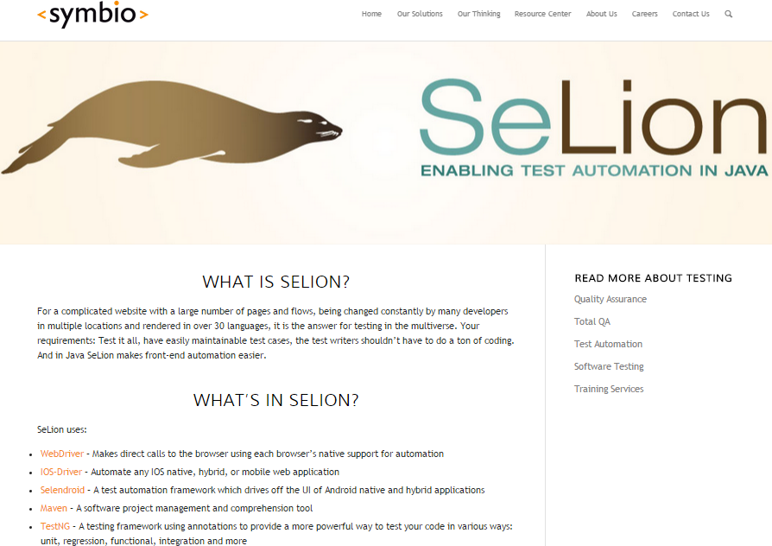
SELION - HOMEPAGE
http://symbio.com/selion-test-automation/
Automation tools analysis

Slide 82
SELION - INTRODUCTION
Helps scale Selenium based testing efforts by offering a set of enhanced capabilities and incorporating best practices recommended by the Selenium community.
Uses Selenium WebDriver, iOS-driver, Selendroid, Maven and TestNG underneath the hood.
Uses Page Objects as a base methodology.
Can automate any IOS native, hybrid, or mobile web application
Cannot integrate with CI, Source Control, Bug Tracking and Team Collaboration.
Target: web-based application testing users and Selenium based user.
Automation tools analysis

Slide 83
SELION - IDE
IDE that SeLion run on
Automation tools analysis

